Slide 1
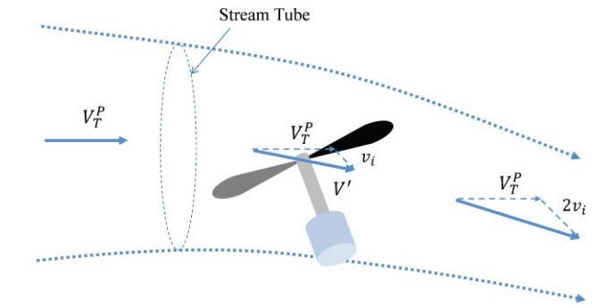
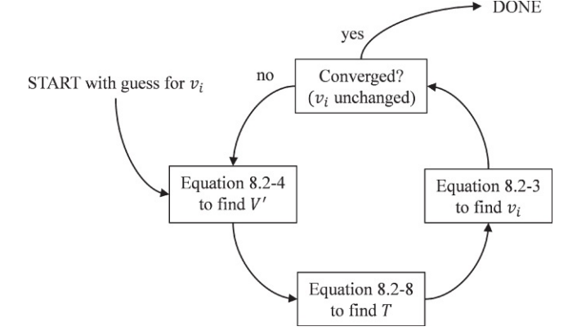
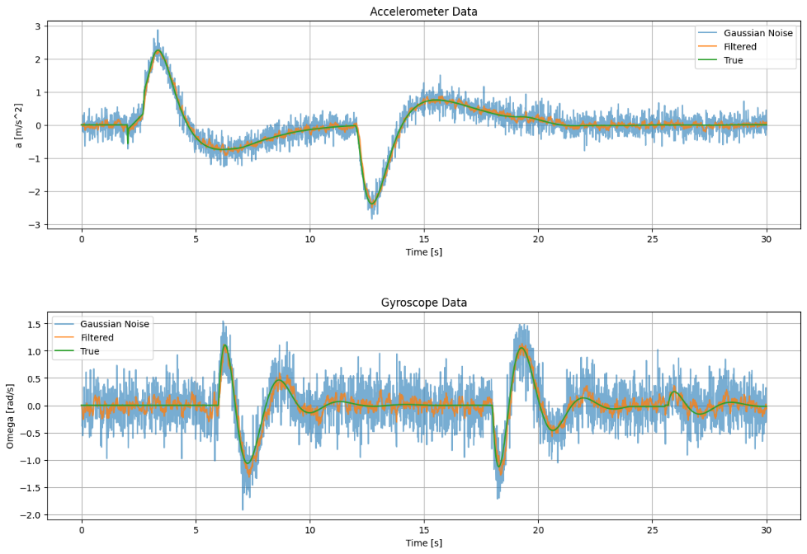
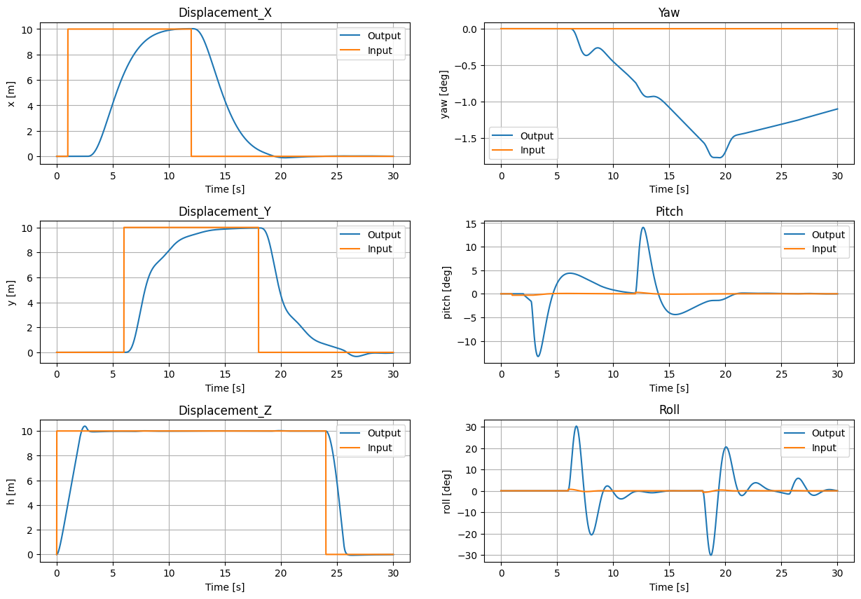
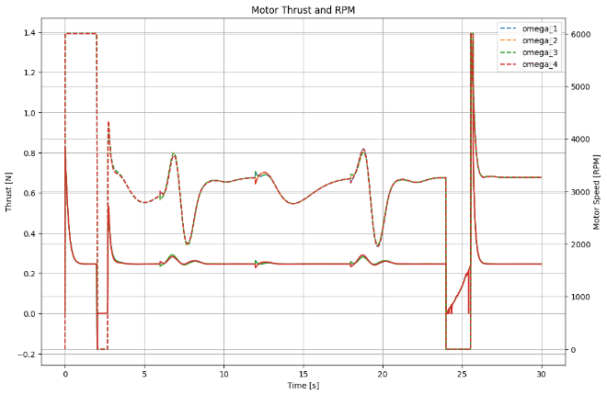
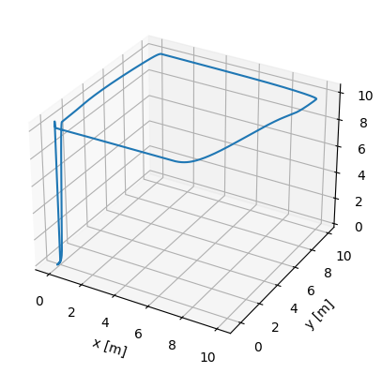



















































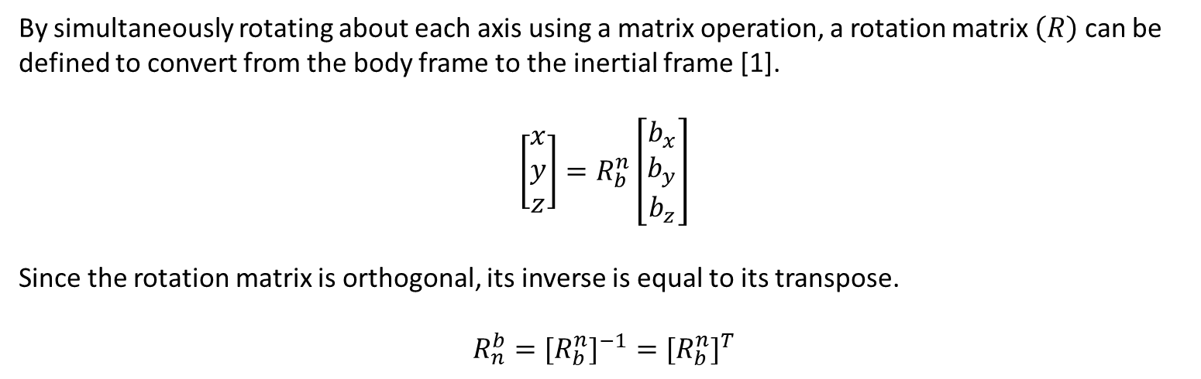























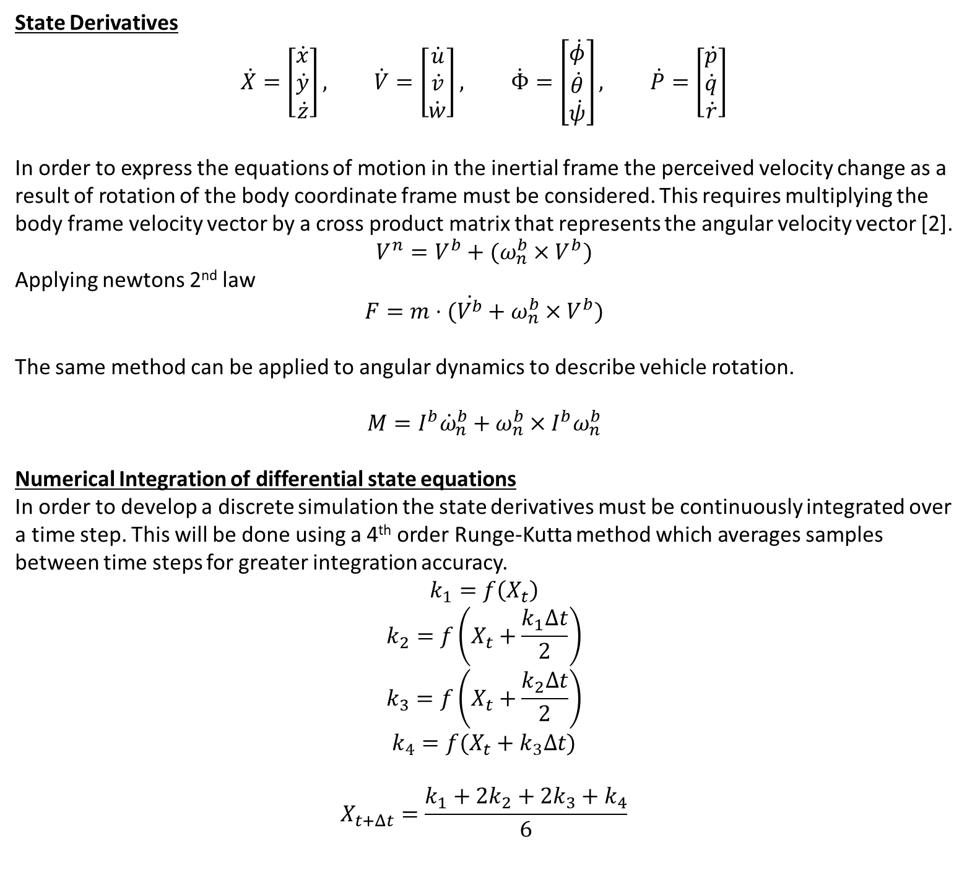









A comparative study of inertial sensor fused attitude state estimation algorithms
in the application of autonomously controlled quad-rotor UAV’s
Alex Crownshaw – supervisor: Dr. Mo Islam
MEng(Hons) Aerospace Engineering
Aims and Objectives
$$Rotation about z$$
$$Rotation about y$$
$$Rotation about x$$
$$b_{y}$$
This project aims to use a simulation-based approach to assess the performance of different attitude state estimation algorithms while providing attitude state updates to a quad-rotor autonomous flight control system (AFCS). By using a simulated model of a quad-rotor UAV; state-estimation/control algorithms can be tested and tuned in a non-destructive, zero-risk environment.
$$b_{y}$$
$$y$$
$$b_{y}$$
$$y$$
$$y$$
$$φ$$
$$φ$$
$$b_{x}$$
$$x$$
$$b_{x}$$
$$x$$
$$φ$$
$$b_{x}$$
$$x$$
$$b_{z}$$
$$θ$$
$$b_{z}$$
$$θ$$
$$φ$$
$Fig 5:v_{i} convergence method [3]$
Objectives
Develop a non-linear time domain simulation of a quad-rotor UAV:
Model equations of motion and apply a numerical integration method (4th order Runge-Kutta).
Create an aerodynamic thrust model to simulate the thrust produced by a propeller under different rotational velocities.
Create a torque model to simulate the torque effects of the rotating propellers.
Model real-world disturbances i.e., Wind gusts
Design a 6DOF closed loop control system architecture with practical control outputs
Develop a PID control loop class accounting for integral windup/sensor noise/derivative kick.
Tune a series of cascaded PID controllers.
Design inertial sensor simulation model using datasheet information.
Apply and compare noise filtering and state-estimation algorithms.
$$b_{z}$$
$$Fig 4: Mass flow with relative velocity components [3]$$
$$z$$
$$z$$
$$z$$
Closed Loop Control Logic
By simultaneously rotating about each axis using a matrix operation, a rotation matrix $\left(R\right)$ can be defined to convert from the body frame to the inertial frame [1].
$$\left[\begin{matrix}x \\ y \\ z\end{matrix}\right]=R_{b}^{n}\left[\begin{matrix}b_{x} \\ b_{y} \\ b_{z}\end{matrix}\right]$$
Since the rotation matrix is orthogonal, its inverse is equal to its transpose.
$$R_{n}^{b}={{[R}_{b}^{n}]}^{−1}={{[R}_{b}^{n}]}^{T}$$
$$x_{input}$$
+
$$E_{x}$$
$$PID_{x}$$
+
Motor Mixing
$$ω_{1}=U_{z}+U_{ψ}+U_{θ}+U_{φ}$$
$$ω_{2}=U_{z}+U_{ψ}−U_{θ}−U_{φ}$$
$$ω_{3}=U_{z}−U_{ψ}+U_{θ}−U_{φ}$$
$$ω_{4}=U_{z}−U_{ψ}−U_{θ}+U_{φ}$$
-
$$U_{x}$$
$$E_{θ}$$
$$PID_{θ}$$
$$U_{θ}$$
$$X_{x}$$
-
+
$$G_{θ}$$
$$ω_{1}$$
$$E_{y}$$
+
$$y_{input}$$
$$U_{y}$$
$$PID_{y}$$
$$E_{φ}$$
$$PID_{φ}$$
-
-
$$U_{φ}$$
$$ω_{2}$$
$$Thrust Model$$
$$X_{y}$$
$$G_{φ}$$
$$ω_{3}$$
$$z_{input}$$
+
$$E_{z}$$
$$PID_{z}$$
-
$$U_{z}$$
$$ω_{4}$$
$$X_{z}$$
+
$$ψ_{input}$$
$$PID_{ψ}$$
-
$$E_{ψ}$$
$$U_{ψ}$$
Equations of motion
$$X_{ψ}$$
Input
+
E
Control Loop
U
Thrust
Model
T
Dynamics Model
X
$$State Estimation$$
-
State Derivatives
$$\dot{X}=\left[\begin{matrix}\dot{x} \\ \dot{y} \\ \dot{z}\end{matrix}\right], \dot{V}=\left[\begin{matrix}\dot{u} \\ \dot{v} \\ \dot{w}\end{matrix}\right], \dot{Φ}=\left[\begin{matrix}\dot{φ} \\ \dot{θ} \\ \dot{ψ}\end{matrix}\right], \dot{P}=\left[\begin{matrix}\dot{p} \\ \dot{q} \\ \dot{r}\end{matrix}\right]$$
In order to express the equations of motion in the inertial frame the perceived velocity change as a result of rotation of the body coordinate frame must be considered. This requires multiplying the body frame velocity vector by a cross product matrix that represents the angular velocity vector [2].
$$V^{n}=V^{b}+(ω_{n}^{b}×V^{b})$$
Applying newtons 2nd law
$$F=m⋅(\dot{V^{b}}+ω_{n}^{b}×V^{b})$$
The same method can be applied to angular dynamics to describe vehicle rotation.
$$M=I^{b}{\dot{ω}}_{n}^{b}+ω_{n}^{b}×I^{b}ω_{n}^{b}$$
Numerical Integration of differential state equations
In order to develop a discrete simulation the state derivatives must be continuously integrated over a time step. This will be done using a 4th order Runge-Kutta method which averages samples between time steps for greater integration accuracy.
$$k_{1}=f\left(X_{t}\right)$$
$$k_{2}=f\left(X_{t}+\frac{k_{1}Δt}{2}\right)$$
$$k_{3}=f\left(X_{t}+\frac{k_{2}Δt}{2}\right)$$
$$k_{4}=f(X_{t}+k_{3}Δt)$$
$$X_{t+Δt}=\frac{k_{1}+2k_{2}+2k_{3}+k_{4}}{6}$$
$$Fig 5:Control$$
Inertial Sensor Model
G
State Estimation
S
Inertial Sensor
Model
Write about inertial sensor model here
$$Fig 1: System Model Diagram$$
Fundamentals of quad-rotor control
6 degrees of freedom with translational and rotational motion around each of its cartesian axes.
underactuated system meaning it has more degrees of freedom (DoF) than can be directly controlled.
By varying the speed of each of the four rotors individually, a quad-rotor can directly control the moments imparted across each principal axis in turn controlling the attitude of the vehicle.
Since the motors are fixed to the body frame of the vehicle the thrust vector will remain parallel to the Z body axis despite any rotation. This means that rotation around the X or Y axis (roll and pitch respectively), will result in the thrust vector no longer being normal to the horizontal plane. This will create a horizontal force imbalance thus leading to horizontal acceleration as governed by Newtons 2nd law.
Results
Write about results here
$$3$$
$$b_{x}$$
$$1$$
$$F_{2}+F_{4}$$
$$F_{1}+F_{3}$$
$$d_{x}$$
$$b_{y}$$
$$M$$
$$b_{z}$$
$$b_{x}$$
$$x$$
$$θ$$
$$θ$$
Propeller thrust can be expressed as the mass flow rate across a propeller disk (with area, $A),$ taking into account the additional velocity (induced velocity, $v_{i}$) created by the propeller [3].
Since the vehicle is in motion, the relative velocity at the propeller must be considered [3].
$$b_{z}$$
$$z$$
$$2$$
$$d_{y}$$
$$4$$
$Fig 2b: xz Plane$
$$A$$
$Fig 2a: xy Plane$
$$V$$
$$V+{2v}_{i}$$
Frames of Reference
Since a quad-rotor has both translational and rotational degrees of freedom, two reference frames must be defined. The body frame remains fixed to the vehicle as it rotates while the inertial frame is fixed irrespective of rotation. Since inertial sensors are fixed to the vehicle, they must report measurements in the body coordinate system.
$$V+v_{i}$$
References
[1] D. K. (David K. . Schmidt, Modern flight dynamics. New York: McGraw-Hill, 2012.
[2] R. F. Stengel, “Flight dynamics,” Aircraft engineering., vol. 77, no. 3, 2005, doi:10.1108/aeat.2005.12777cae.002.
[3] B. L. Stevens, F. L. Lewis, and E. N. Johnson, Aircraft control and simulation : dynamics, controls design,
and autonomous systems, Third edition. Hoboken, New Jersey: John Wiley & Sons, 2016.
[4]
$$Fig 3: Mass flow through propeller disk$$

